Slide 1
Software Project Lab-1 Project name: Malware Detecting System
01
Presented by:
Tanjuma Tabassum
Roll:1312
Supervised by:
Moumita Asad

Slide 2
Description:
02
Malware is a software that is specifically designed to damage computer system or gain unauthorized access to a computer system. In order to protect a computer from infection or remove malware from a computer system, it is essential to accurately detect malware. So, I have decided to build up a malware detecting system. Accordingly, the project will take a file as input and check whether the file is containing malware or not. Every file is going to be scanned, there will be generated a hash first. Once that hash is generated, the malware detector will try to match hash with its own file that file should contain hashes of known malicious files. If there is found a match, then this will be sure that the file contains malware. And then I will conduct a static analyzer.

Slide 3
Overview:
03
Find out the hash value of known malicious files by SHA-512 and save them in a single file
Reads a file as a single string as input and find the hash value of this file also by SHA-512
Matches the hash value of input file and the hash value of malware using a string matching algorithm
If there finds a match, then the input file contains malware and conduct a static analyser

Slide 4
Progress so far:
04
Knowing and studying about my project topic and main algorithms going to used in my project as I didn’t have any idea about malware detection
Knowing SHA-512 algorithm in details
Implementation of SHA-512 algorithm that finds the hash value of any input file and the malicious files.

Slide 5
Description of SHA-512:
05
Input formatting
Hash buffer initializing
Message processing
Output

Slide 6
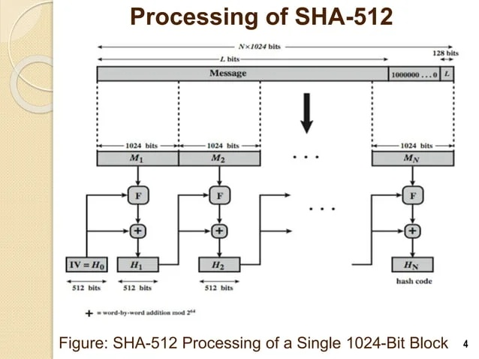
06

Slide 7
Input Formatting:
07
SHA-512 Takes full string from a file as input with a maximum length of less than 2^128 bits and produce a output as 512 bits message digest. The input is processed in 1024 bit blocks.
Append padding bits: the message is padded so that its length is congruent to 896 modulo 1024.padding is always added. The padding consists of a single 1 bit followed by the necessary number of 0 bits.
Append length: A block of 128 bits is appended to the message. This is an unsigned 128 bit integer and contains the length of the original message.

Slide 8
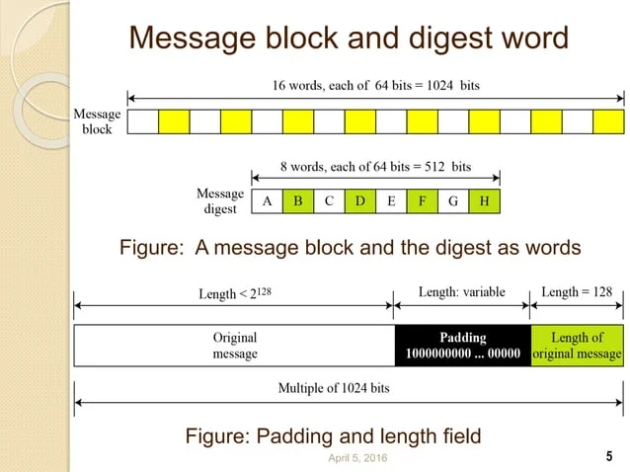
08

Slide 9
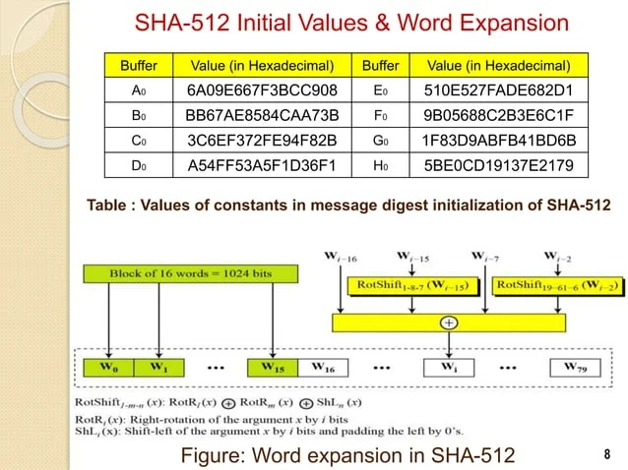
Hash buffer initializer: Initialize 8 hash buffer
09

Slide 10
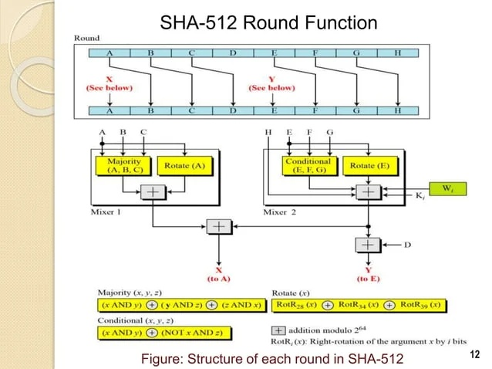
Message processing:
10

Slide 11
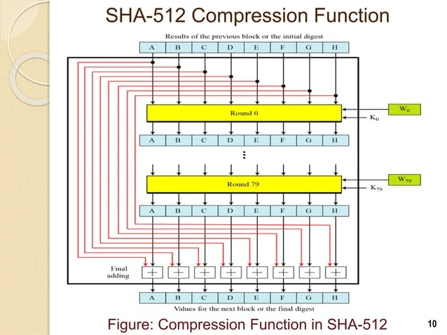
11

Slide 12

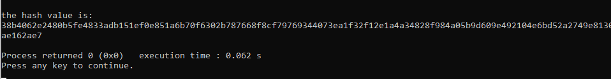
Input:
12
Output:

Slide 13
Challenges:
13
As I had no idea about malware detection, I had to study about the full process of malware detection and specially SHA-512 algorithm which is quite difficult and seems a complex algorithm
It took many days to realize the SHA-512 algorithm in details and implementing a new algorithm like SHA-512
Faced challenge in input formatting specially converting a string to a binary string
Converting binary string to hexadecimal string

Slide 14
Future works:
14
Now I read a text file as input, next I will read a exe file as input and find it’s hash value
Knowing and studying about string matching algorithm and Implementing KMP string matching algorithm
Decide if the file containing malware or not
If the file contains malware ,then conduct static analysing

Slide 15
Tools used:
15
Language: C++
Github link:
https://github.com/TANJUMAJERIN/SPL-1

Slide 16
16
THANK YOU!

